Slide 1

What is Accessibility?
Panel Talk, NICAR, March 2023
axle-lab.com
A short, introductory talk on important concepts in accessibility.
Frank Elavsky, PhD student at Carnegie Mellon University

Slide 2
Who am I? A data visualization + accessibility researcher and engineer
Research: Carnegie Mellon and [big tech company].
Organize: DataVizA11y.
Contribute: W3C’s ARIA Working Group as an invited expert.
Create: Tools for designers and engineers who want to make accessible visualizations.

Slide 3
Accessibility (some working definitions):

Slide 4
Accessibility (some working definitions):
1. The qualities that make an experience open or usable to all.

Slide 5
Accessibility (some working definitions):
1. The qualities that make an experience open or usable to all.
2. The qualities that make an experience open or usable specifically for people with disabilities.

Slide 6

Access is a human right
Accessibility is an internationally recognized human right.
It is the morally and ethically correct thing to do.
https://www.un.org/development/desa/disabilities/convention-on-the-rights-of-persons-with-disabilities/article-9-accessibility.html
https://www.un.org/development/desa/disabilities/convention-on-the-rights-of-persons-with-disabilities/article-10-right-to-life.html

Slide 7
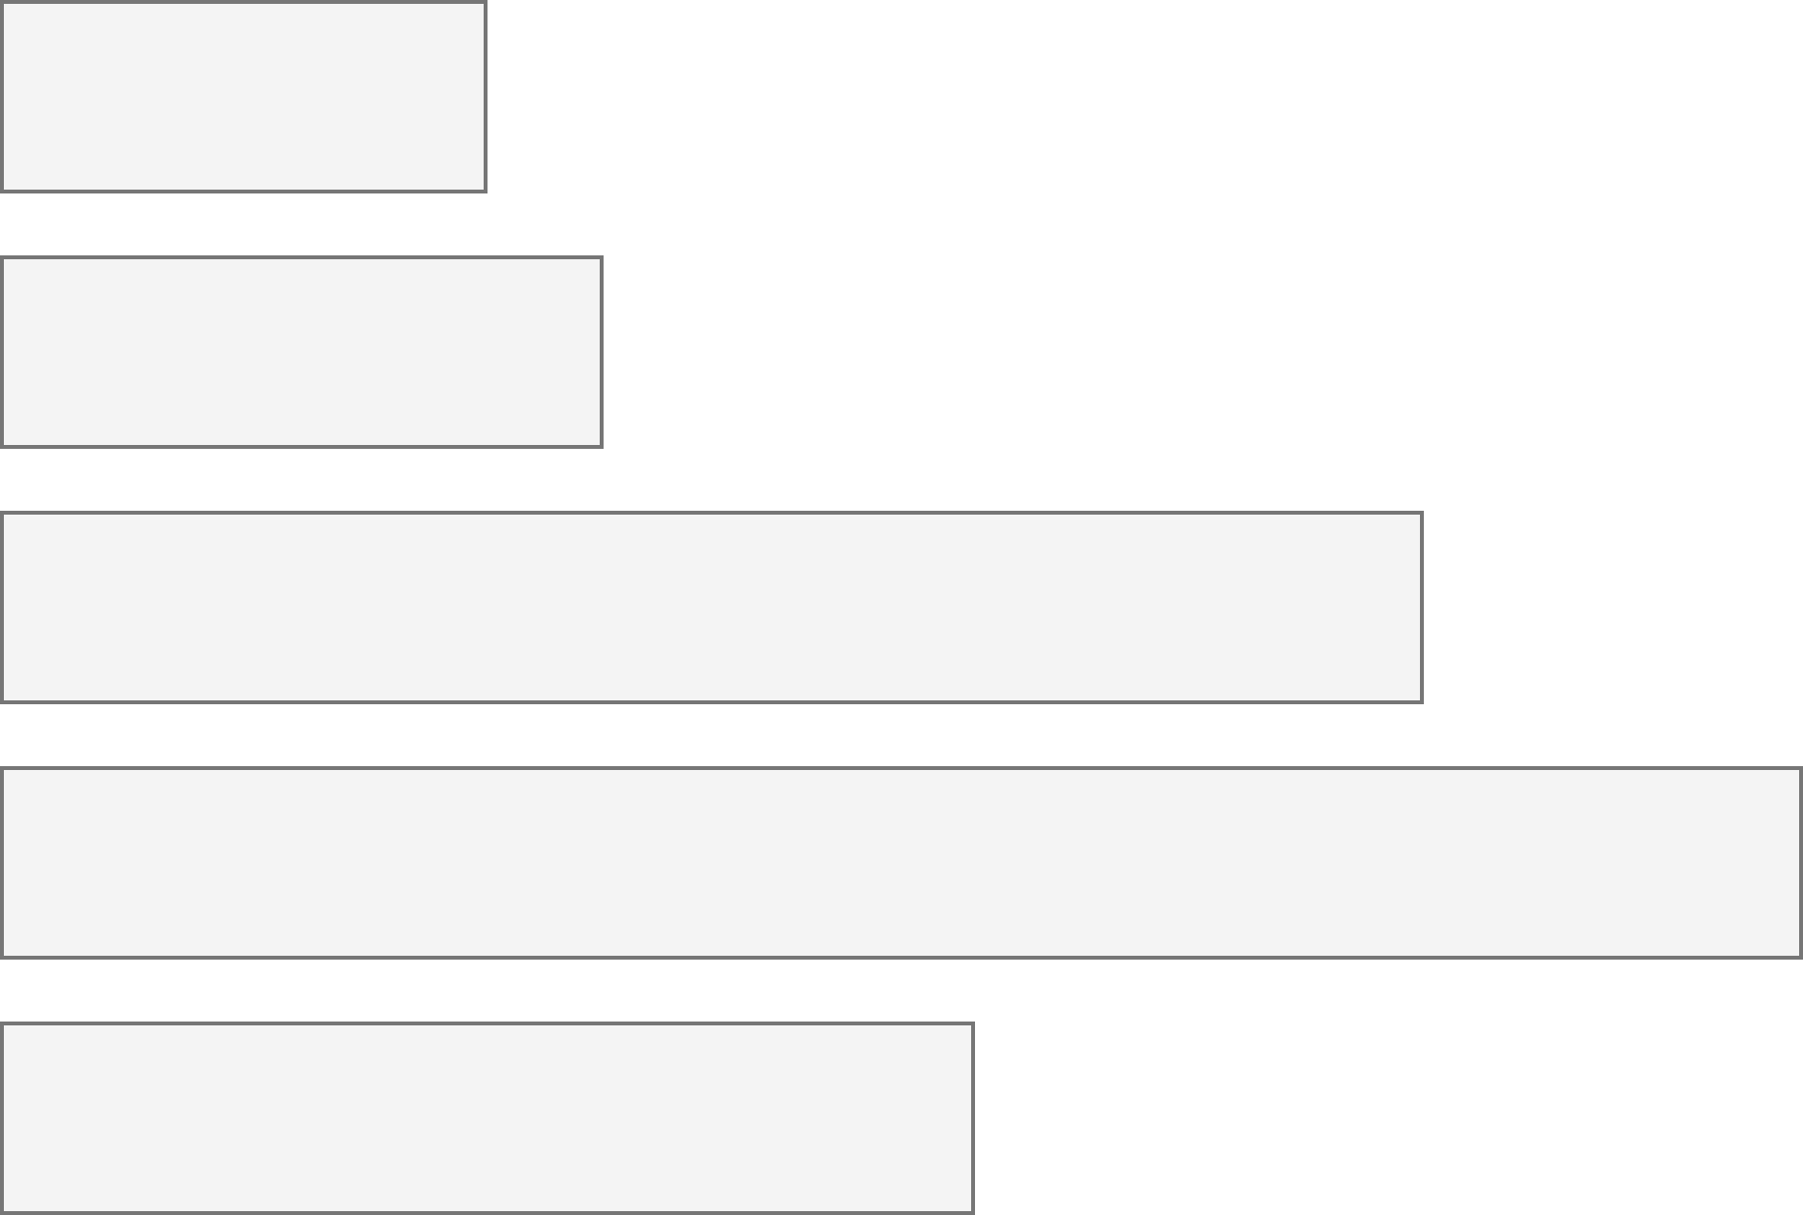
26% of people living in the United States self-report living with a disability that affects their daily life.
4.1%
Color Vision Deficiency
4.5%
Blindness, Low Vision
10.8%
Cognitive, Neurological
13.7%
Motor, Dexterity
7.4%
Vestibular, Motion
Source: Okoro et al. “Prevalence of Disabilities and Health Care Access by Disability Status and Type Among Adults”
Introduction - Example - Design - Evaluation - Results - Future Work
Notes:
But how do designers, developers, and creators of visualizations know whether something they’ve made is accessible or not for people with disabilities?

Slide 8
Every area of disability affects data visualization work.
Color Vision Deficiency
Visual design
4.1%
Non-visual design
4.5%
Blindness, Low Vision
Narrative design, statistics, storytelling
10.8%
Cognitive, Neurological
13.7%
Motor, Dexterity
Interaction design, device considerations, performance
7.4%
Vestibular, Motion
Animation, transitions
Introduction - Example - Design - Evaluation - Results - Future Work
Notes:
But how do designers, developers, and creators of visualizations know whether something they’ve made is accessible or not for people with disabilities?

Slide 9
Creators
9

Slide 10
Creators
Tools
10

Slide 11
Creators
Tools
Things
11

Slide 12
Creators
Tools
Things
Future Things
12

Slide 13
But how much of this is inaccessible?
Creators
Tools
Things
Future Things
13

Slide 14
97-99%
Source: World Wide Web Consortium. “The WebAIM Million Report.” 2019-2022
Creators
Tools
Things
Future Things
14

Slide 15
Remove barriers that already exist
Creators
Tools
Things
Future Things
15
Notes:
Common, the way most people do this work

Slide 16
Making sure we don’t build new barriers
Creators
Tools
Things
Future Things
16

Slide 17
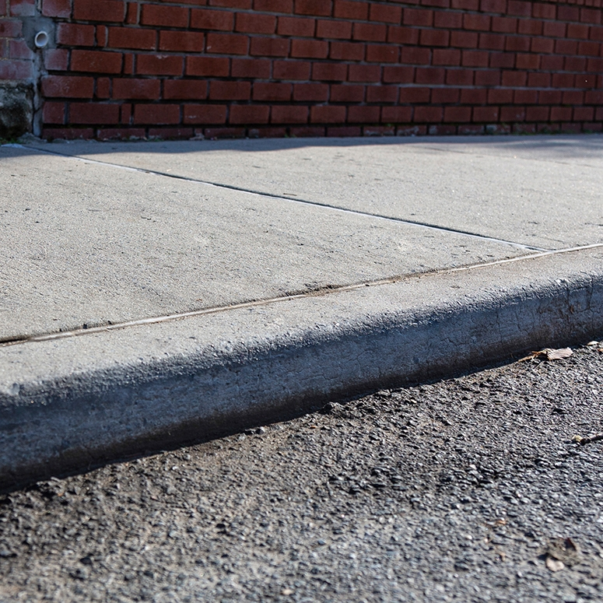
Concept: social vs medical models of disability
a “curb”

Slide 18
What do we do about curbs in our cities?

Slide 19
Medical model: the body is the cause of disability (according to normative standards).

Slide 20
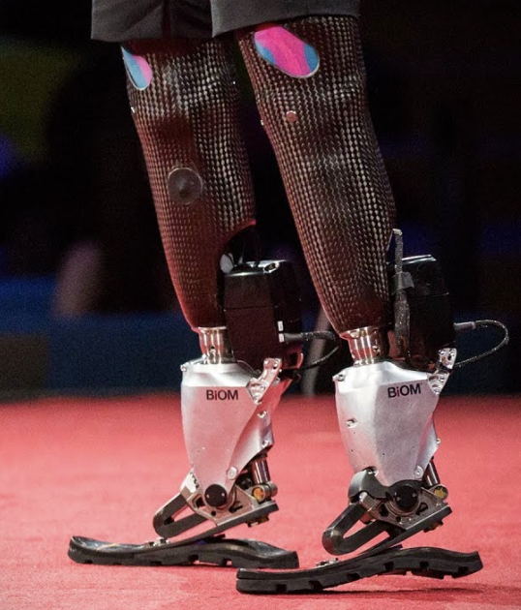
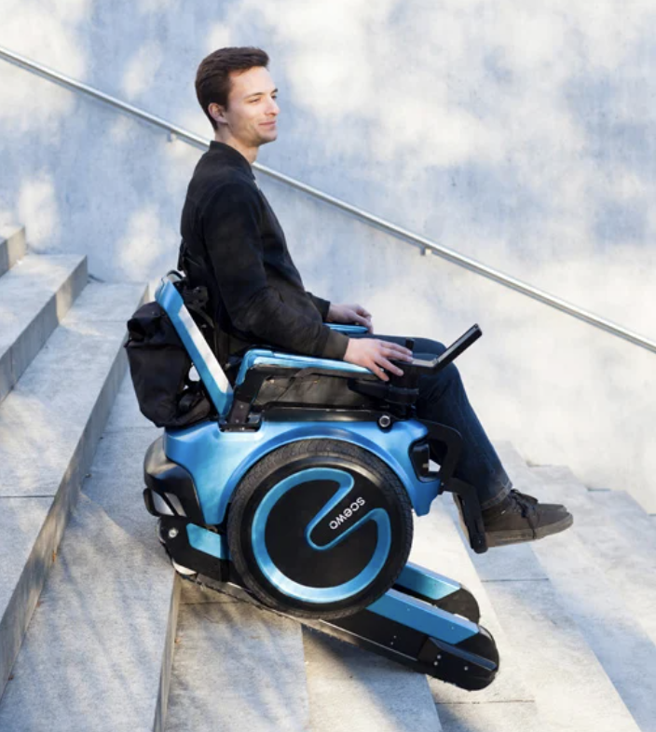
Medical model: augment or “cure” the body.

Slide 21
Social model: The curb is the source of disability (a “barrier” to access).

Slide 22
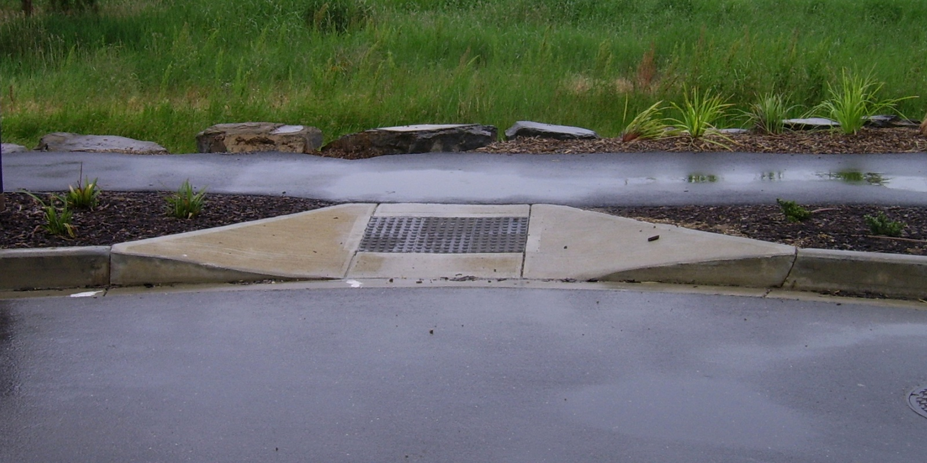
Social model: Cut the curb.

Slide 23
Concept: Situational Impairment

Slide 24
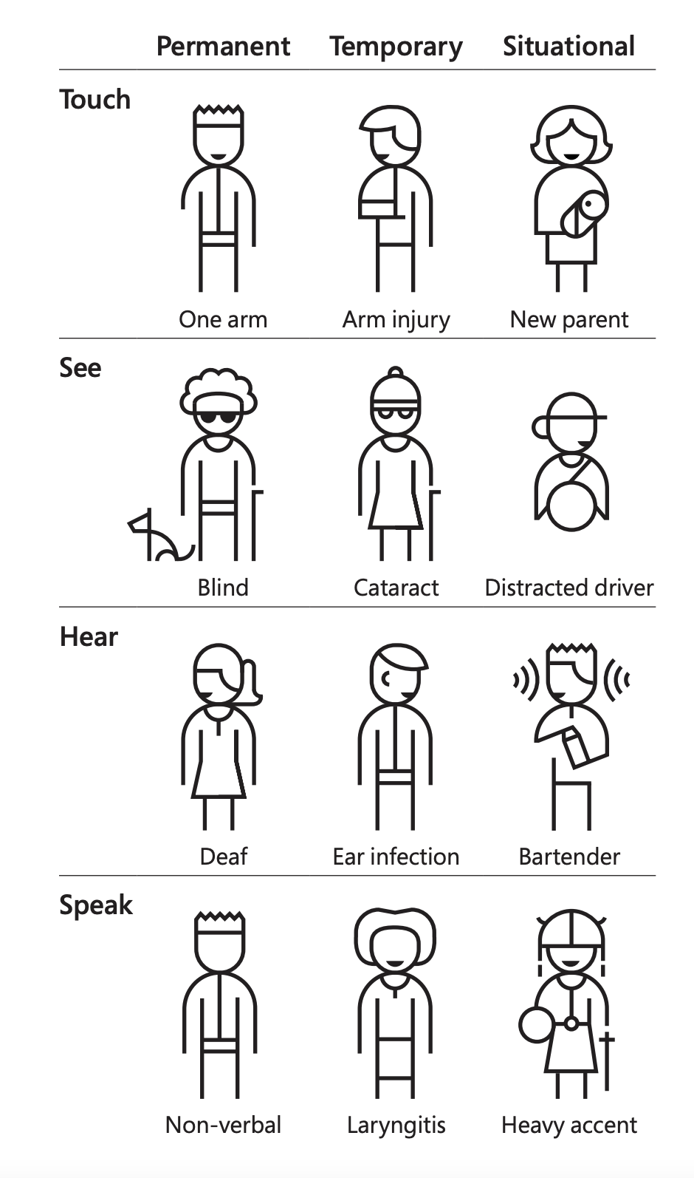

Slide 27
We all experience situational impairment in our daily lives. Accessibility benefits everyone!

Slide 28
Concept: Situational Impairment “Design for One, Extend to All”
Microsoft’s Inclusive Design 101 Toolkit: https://download.microsoft.com/download/b/0/d/b0d4bf87-09ce-4417-8f28-d60703d672ed/inclusive_toolkit_manual_final.pdf

Slide 29
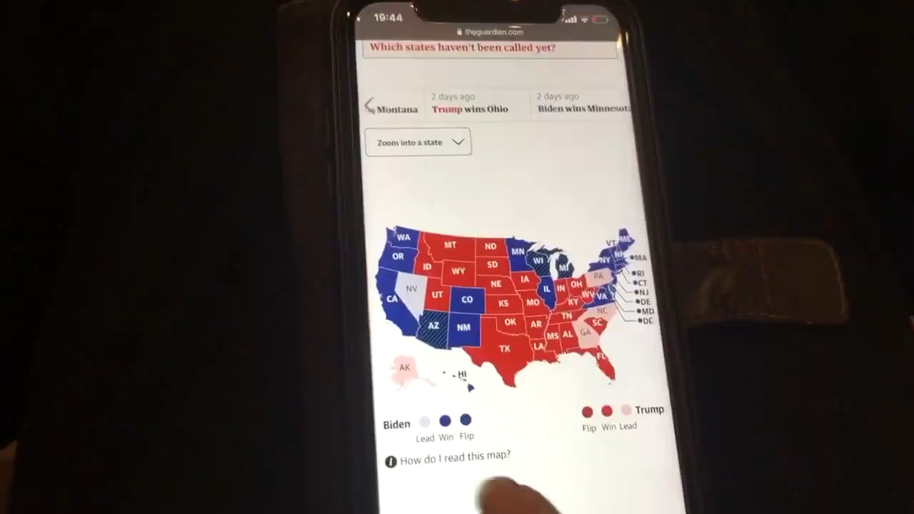
What is an inaccessible experience like?
Credit: Sarah Fossheim on twitter

Slide 30
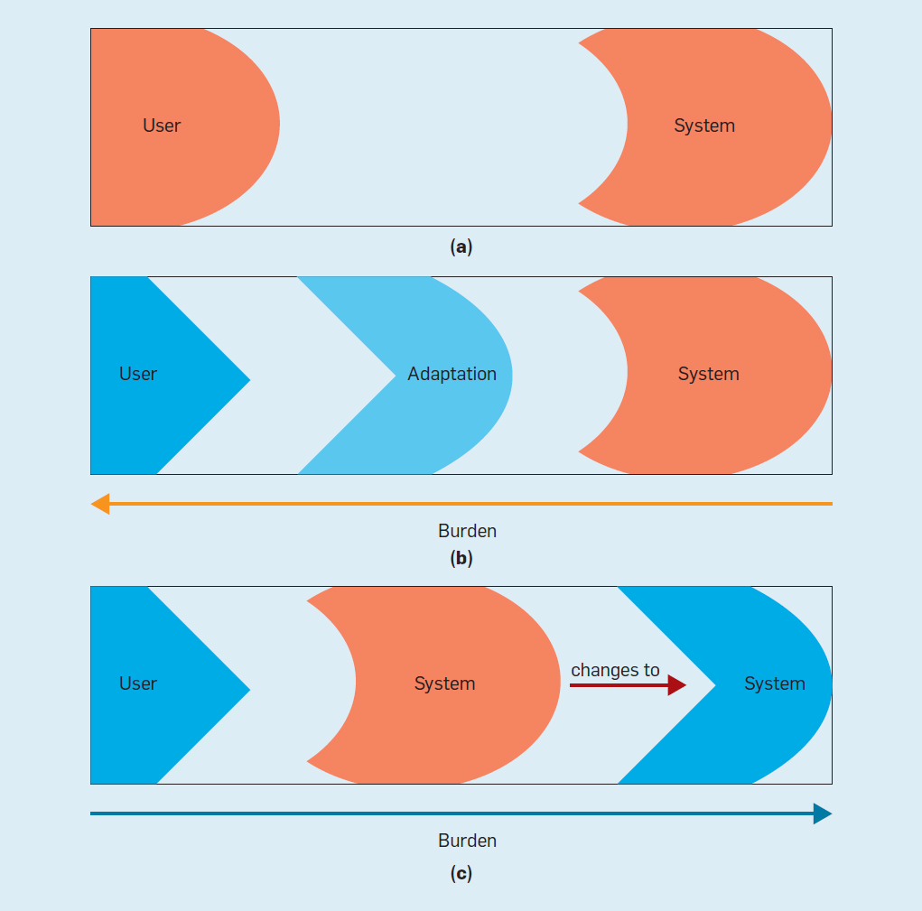
Concept: Ability Assumptions
(Wobbrock et al) https://cacm.acm.org/magazines/2018/6/228034-ability-based-design/fulltext

Slide 31
Concept: Ability Assumptions
(Wobbrock et al) https://cacm.acm.org/magazines/2018/6/228034-ability-based-design/fulltext

Slide 32
Concept: Ability Assumptions
(Wobbrock et al) https://cacm.acm.org/magazines/2018/6/228034-ability-based-design/fulltext

Slide 33
Q/A
Happy to answer questions about how to do this work professionally (design, engineering, research, education)
as well as any questions about data visualization and accessibility more broadly (including tools, challenges, what lies in the future)

Slide 34
Resources
A resources repository!
My twitter (@FrankElavsky)
Chartability
Bonus content: the last half of this slide deck includes a little toolkit for checking visualizations for accessibility.

Slide 35
Visualization and accessibility toolkit
If you are just getting started, below are some really approachable techniques for ensuring your visualizations don’t contain some of the most pernicious barriers.

Slide 36
Perceivable
Can someone perceive this in multiple ways? Is each way easy?

Slide 37
Perceivable Checklist:
High Contrast
CVD-Safe + Redundant Encoding
Alt Text

Slide 38
Design with high contrast
Colorblindness Disproportionately Overrepresented in A11y Resources
Colorblindness Disproportionately Overrepresented in A11y Resources
Colorblindness: % of People
Colorblindness: % of People
4%
4%
Low Vision: % of People
Low Vision: % of People
25%
25%
Colorblindness: # of Resources
Colorblindness: # of Resources
51
51
Low Vision: # of Resources
Low Vision: # of Resources
5
5
Notes:
https://projects.susielu.com/viz-palette

Slide 39
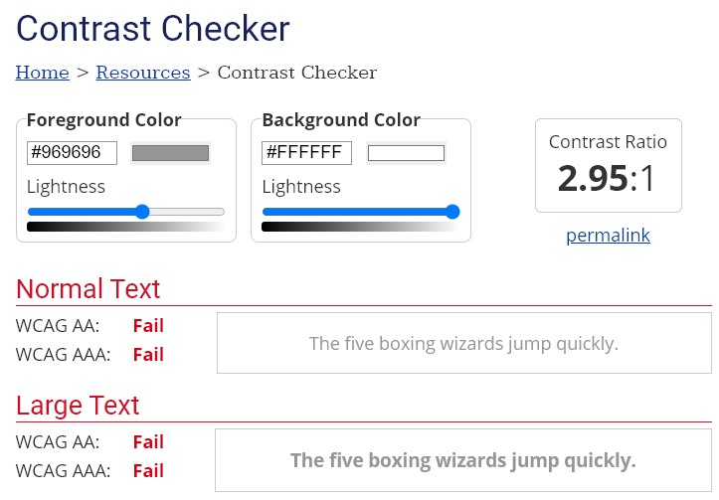
Use High Contrast Text
Text needs at least 4.5:1 contrast against its background.
Large text (bold and 16pt or larger) can be 3:1 or higher.

Slide 40
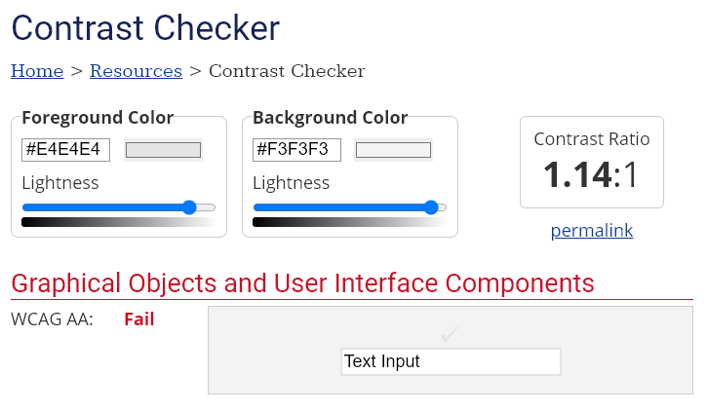
Use High Contrast Geometries
Chart elements need at least 3:1 contrast against their background.

Slide 41
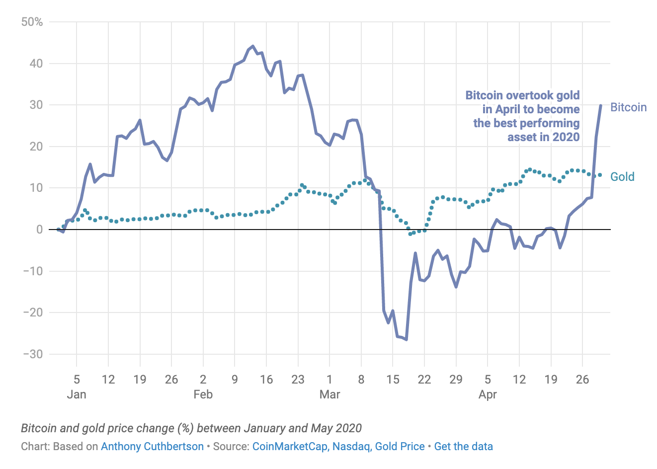
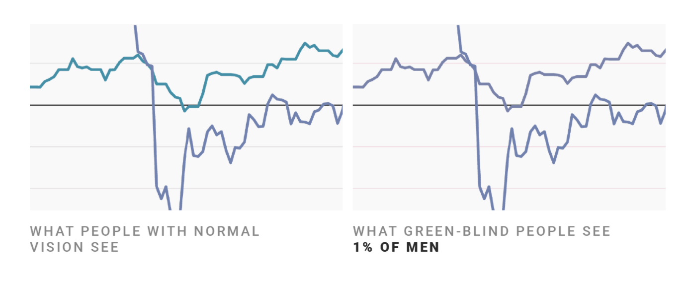
Don’t rely on color alone!
(Muth) https://blog.datawrapper.de/colorblindness-part2/

Slide 42
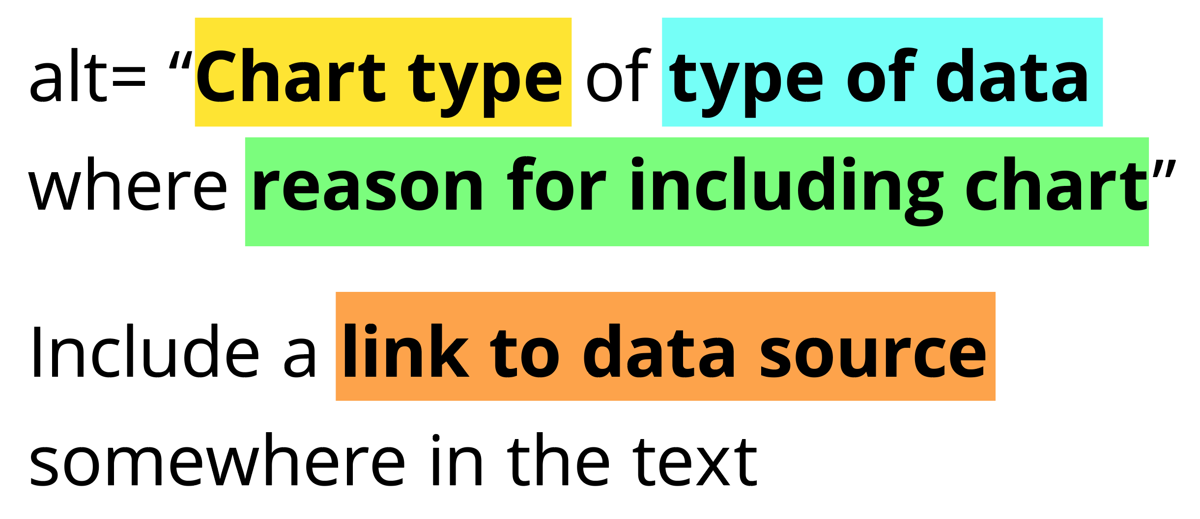
Add alt text
There is great research on alt text, but the most important thing to know is that you should add it to every image you post online (including twitter), in a document, or presentation.
Guidance: https://medium.com/nightingale/writing-alt-text-for-data-visualization-2a218ef43f81

Slide 43
Perceivable Evaluation Toolkit:
Contrast Checker
Safe color design
CVD Checker
Redundant encoding design ideas
Alt Text

Slide 44
Operable
Can someone operate this in multiple ways? Is each way easy?

Slide 45
Operable Checklist:
Mouse
Keyboard-only
Screen Reader

Slide 46
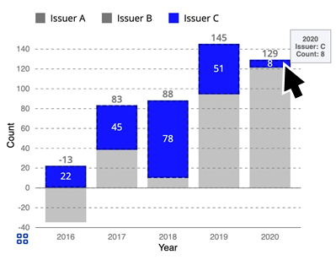
Ensure Keyboard Access (if interactive)

Slide 47
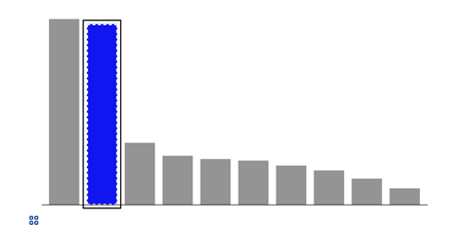
Indicate keyboard focus, use multi-modal style
This is a keyboard focus indicator (outer border) with the same styling effect applied on mouse hover (inner dashed white lines and blue fill)

Slide 48
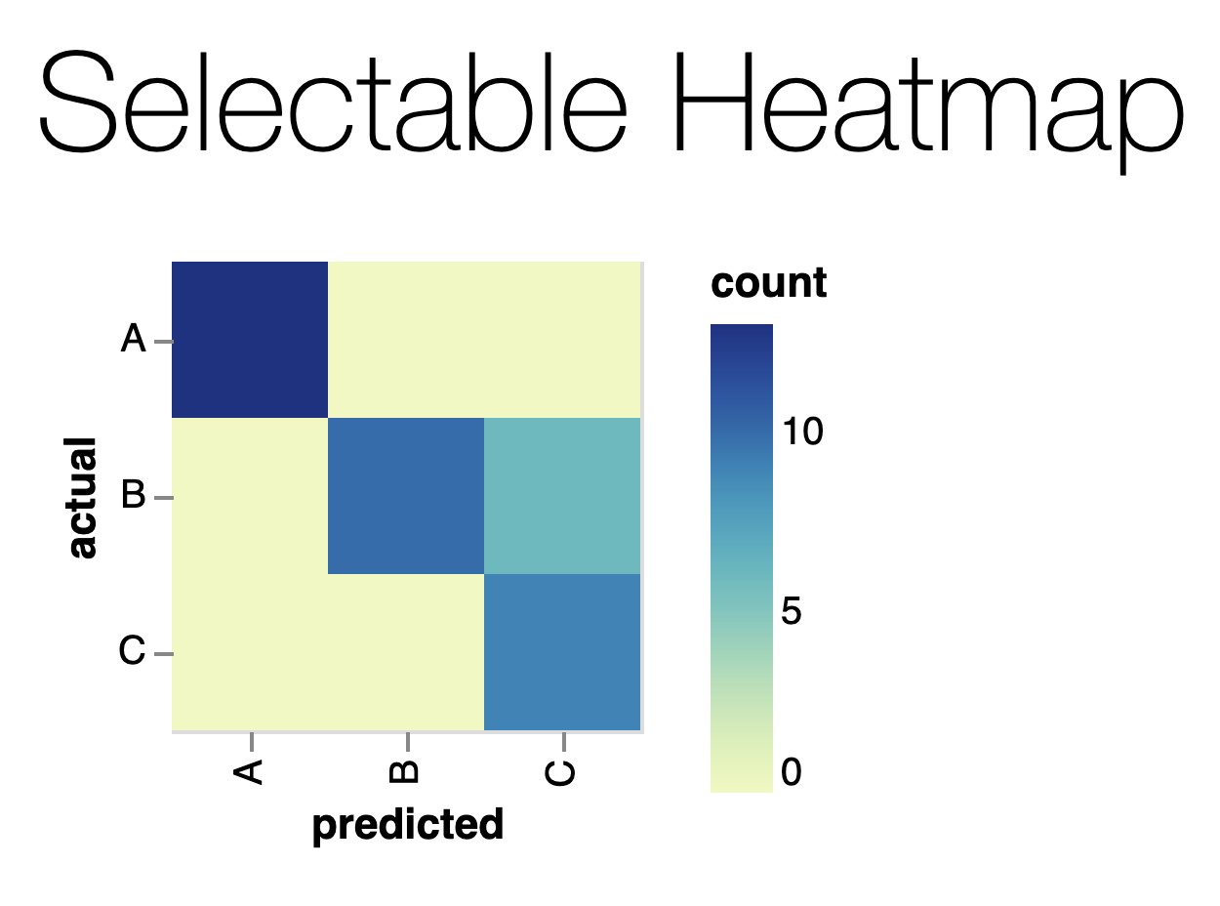
Why Keyboard-only?
Some things work for screen readers but not for keyboard-only users!
https://vega.github.io/vega-lite/examples/selection_heatmap.html

Slide 49
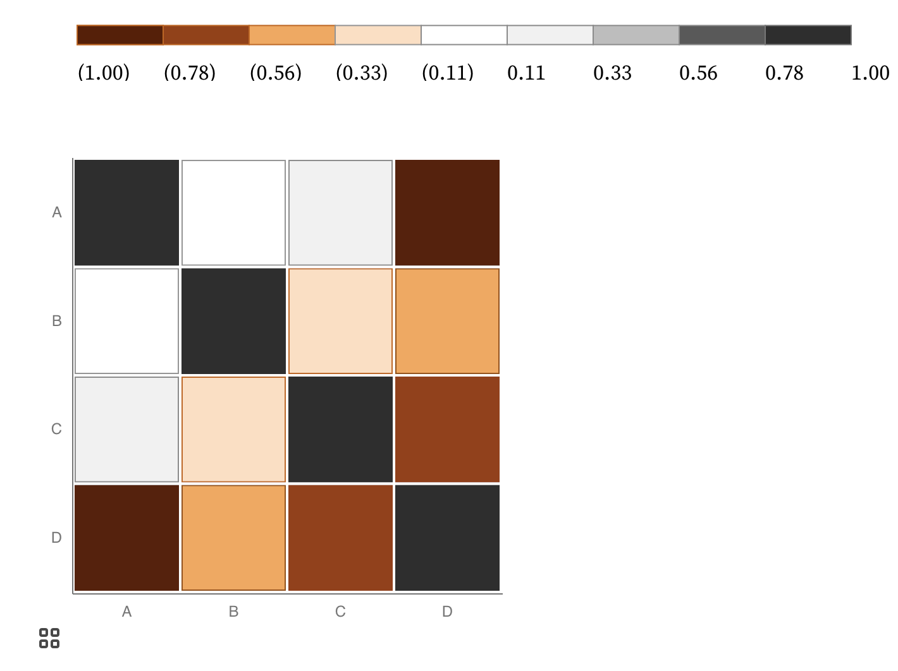
Keyboard only example:
https://observablehq.com/@frankelavsky/experimental-color-scale-textures

Slide 50
Operable Evaluation Toolkit:
Use your mouse: can it do something meaningful? (tooltip, click event, etc) If so:
Test using a keyboard-only: can you navigate and use keyboard activation (spacebar/enter) on the visualization?
Test using a screen reader: Can you use a screen reader to navigate and use keyboard activation on the visualization?

Slide 51
Understandable
Can someone understand this in multiple ways? Is each way easy?

Slide 52
Understandable Checklist:
Descriptive title, summary, or caption
Data table or data download
Reading level

Slide 53
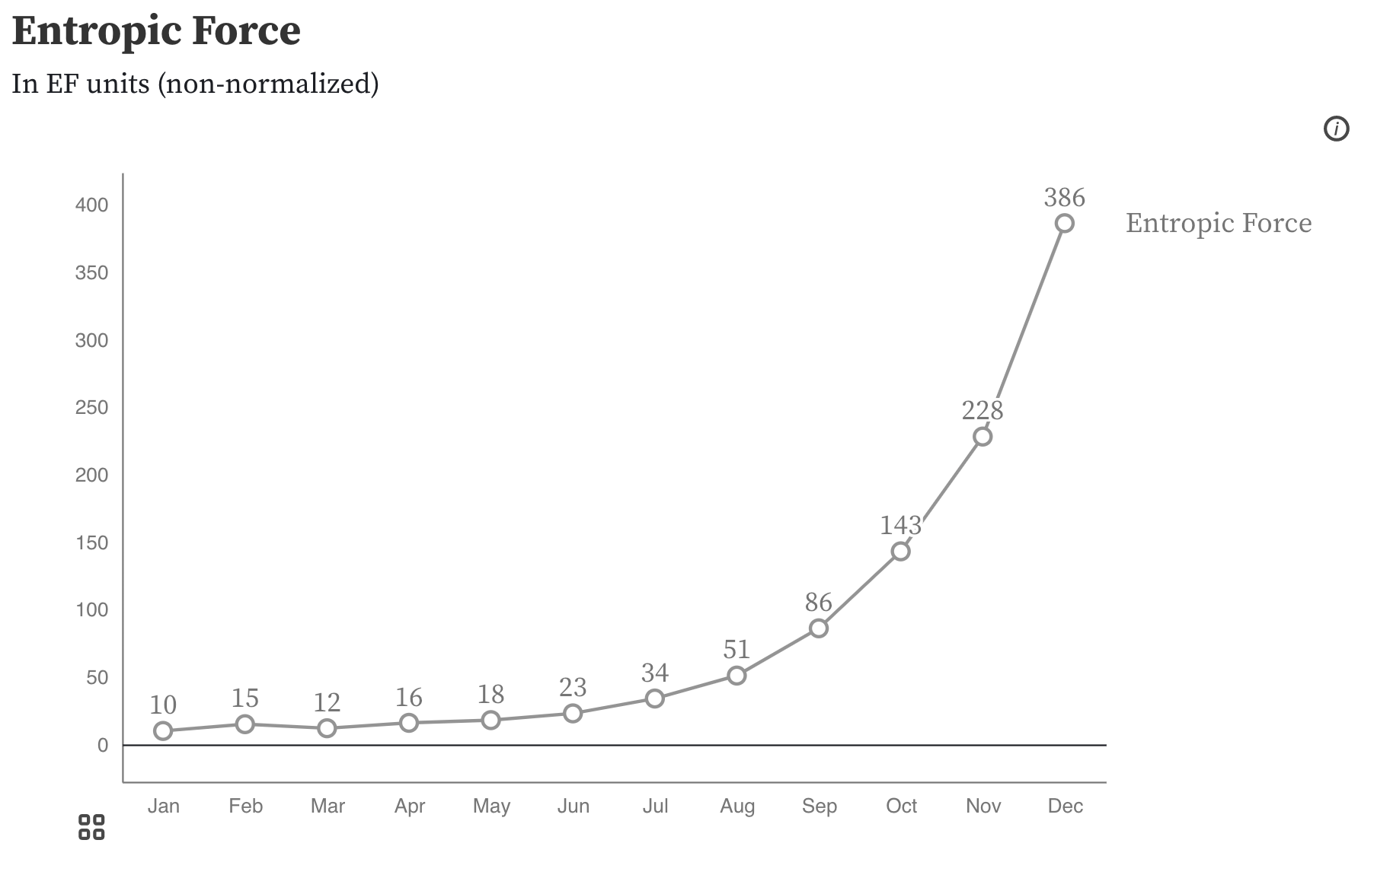
Non-descriptive titles are inaccessible

Slide 54
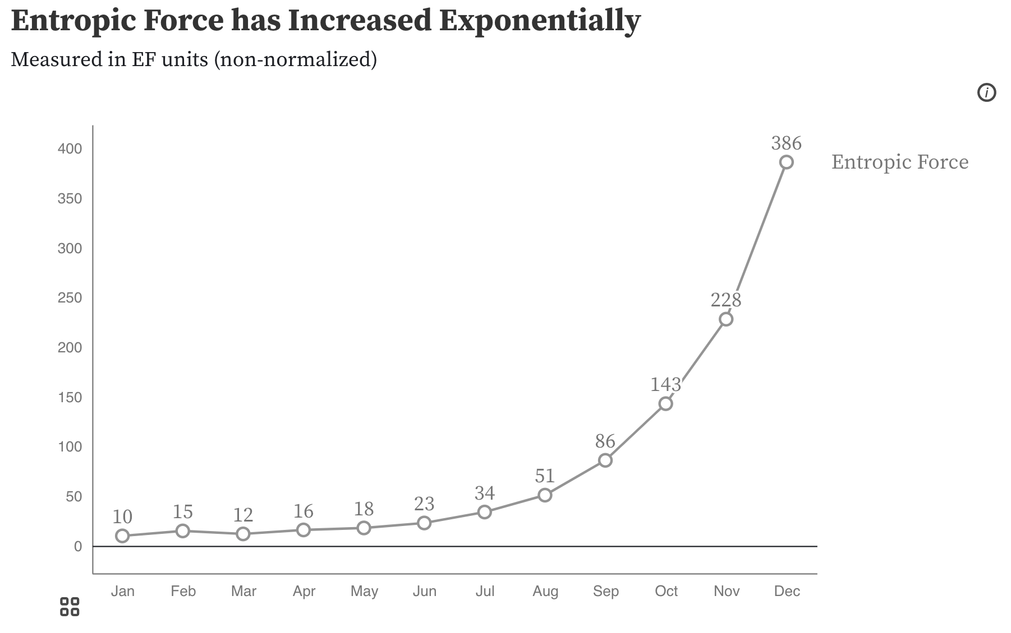
Descriptive titles have summaries/takeaways

Slide 55
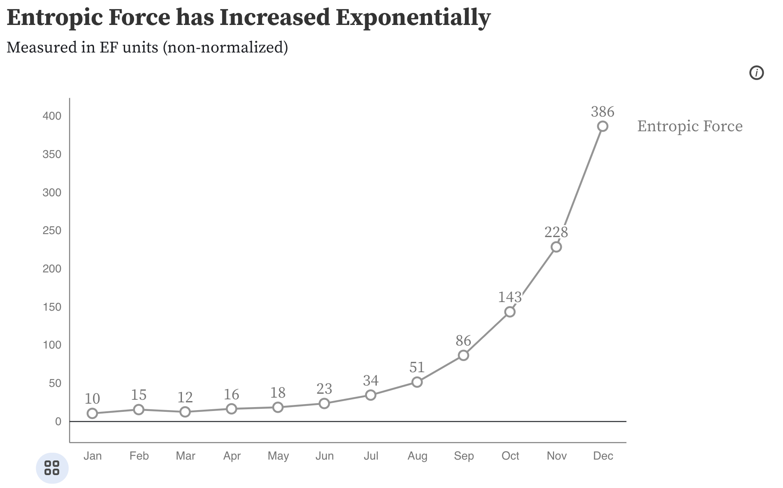
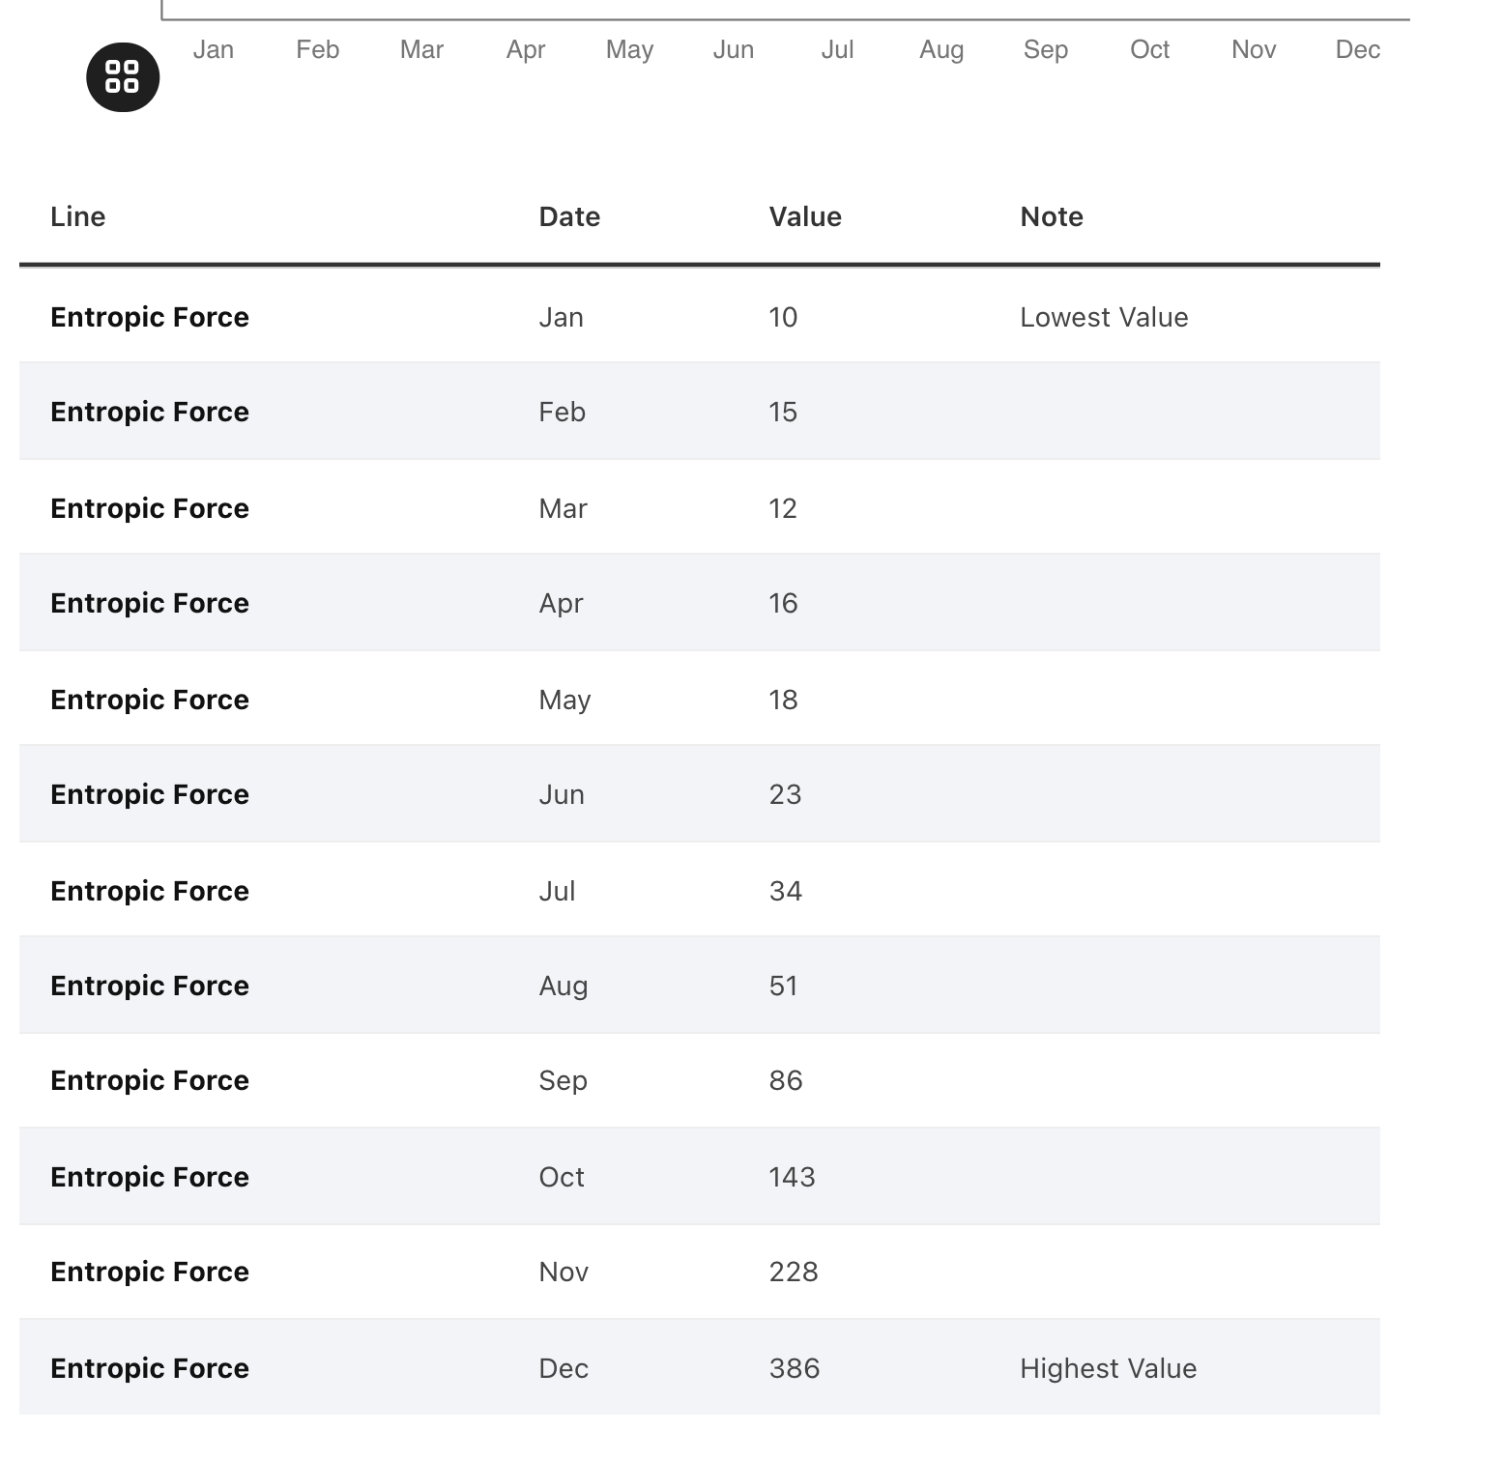
All charts should have data available!

Slide 56
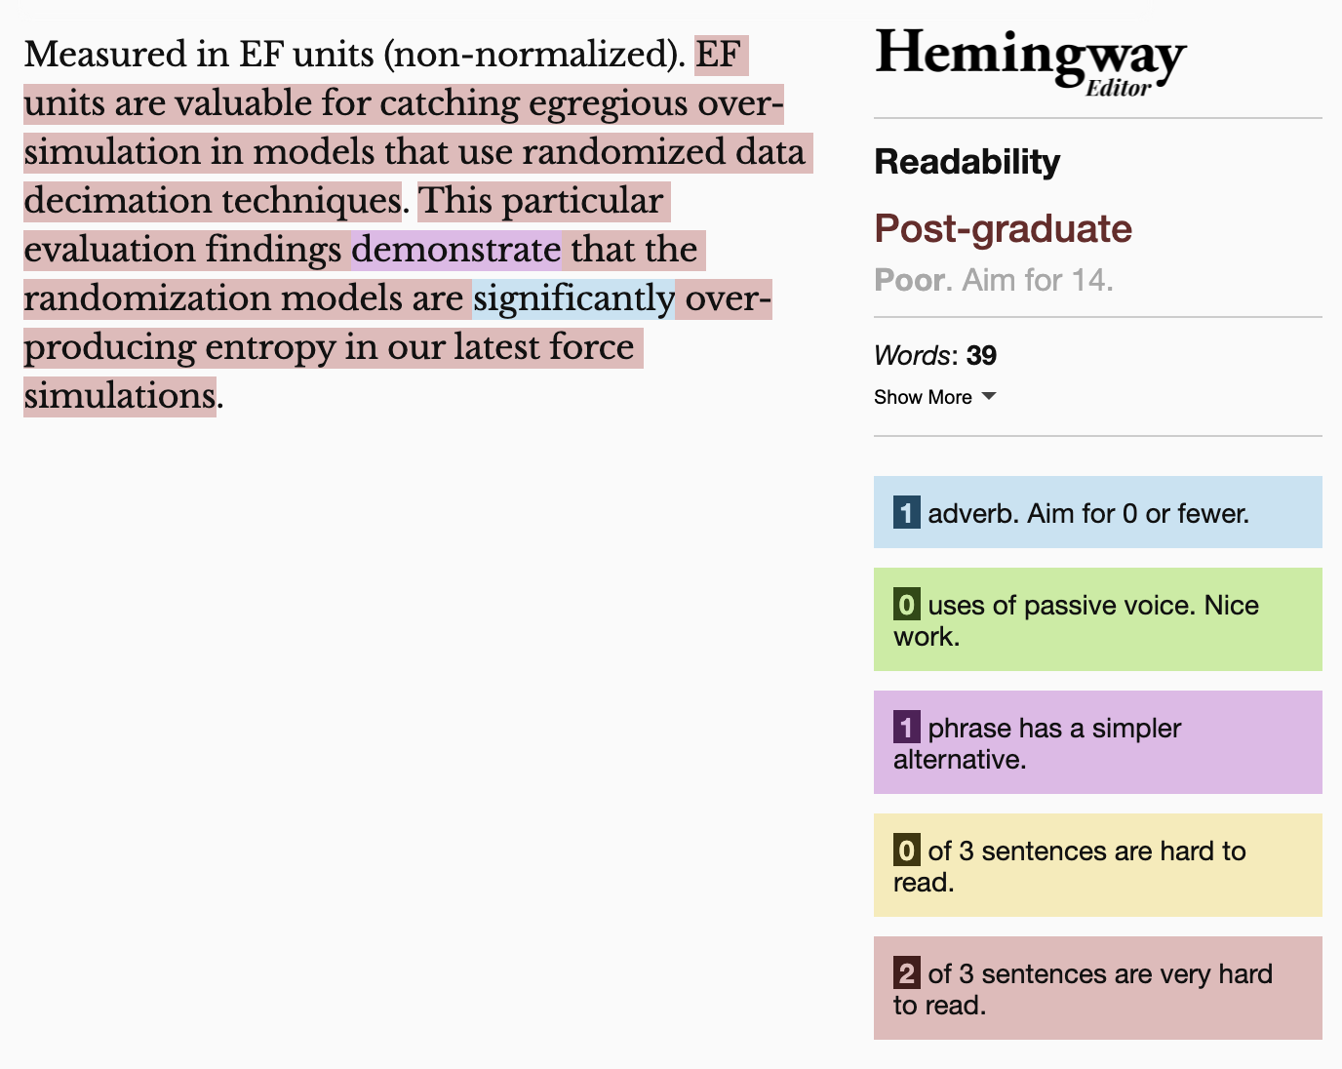
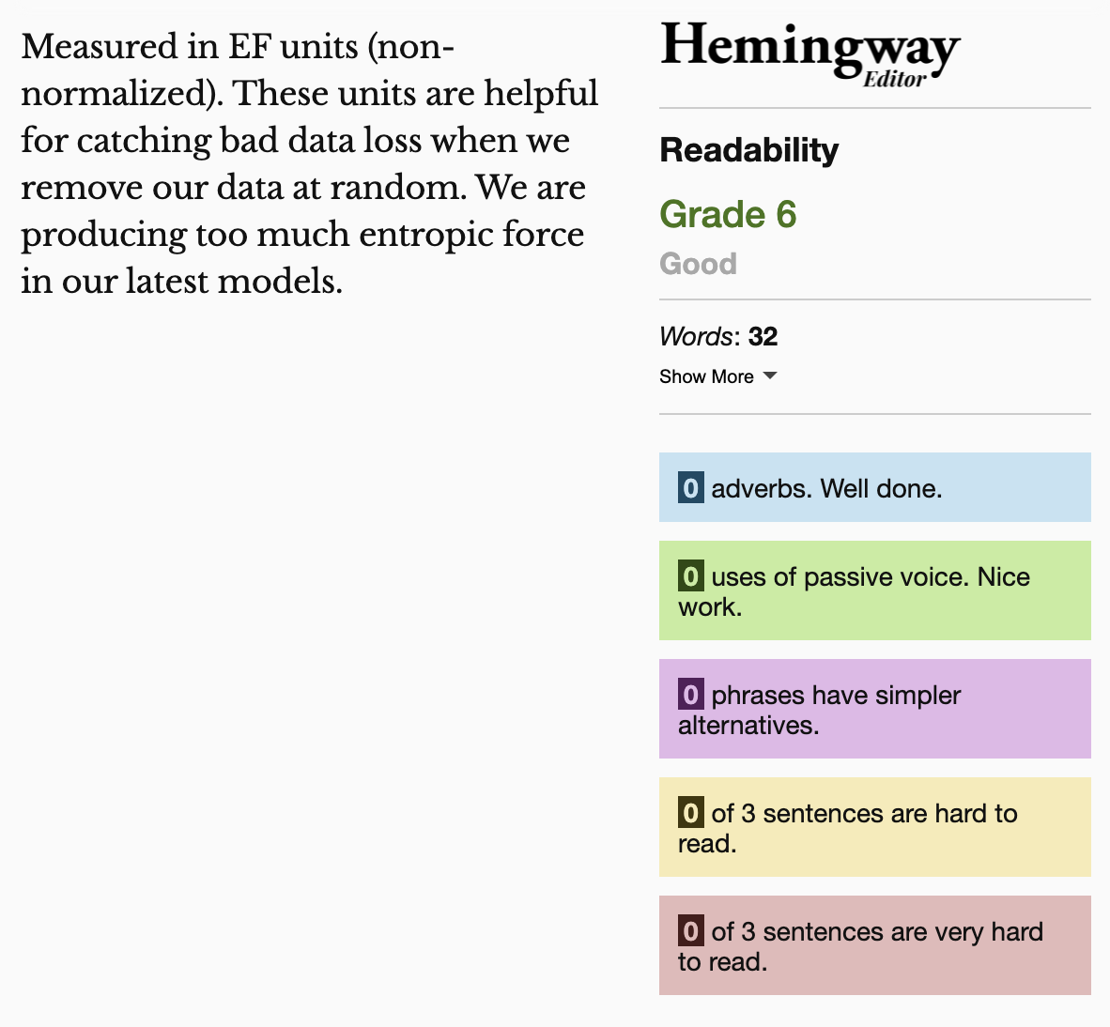
Keep summaries as non-technical as possible
If the topic is technical, provide a “plain language” summary somewhere close by that is easy to find (either in the same location or with by providing a link).

Slide 57
Understandable Evaluation Toolkit:
Is there a descriptive title, summary, or caption?
Is there an accessible table or downloadable data file provided?
Is the descriptive text supporting the visualization presented at a reading level at grade 9 or below?

